Slide 1





Employee data analysis using excel
NT NAME: R. K Soniyaa sumith
REGISTER NO:312209012
NAANMUDHALVAN ID
DC2F60AAC9AB8249EA94730F7A21A799
DEPARTMENT: B.Com General
COLLEGE: CTTE college for women

Slide 2
Project Title
Employee salary analysis using excel

Slide 3
Agenda
Problem statement
Project overview
Who are the end users
Our solution and its value proposition
Dataset description
The “WOW” in our solution
Modelling
Result
Conclusion

Slide 4
Problem statement
Salary analysis is done to evaluate and understand various aspects of employee compensation within the organisation. Fair compensation, market competitiveness, budget management are some of the key reasons why salary analysis is conducted

Slide 5
Project overview
Salary analysis is made using employee id, department, salary level, employee type , work location and working days.

Slide 6
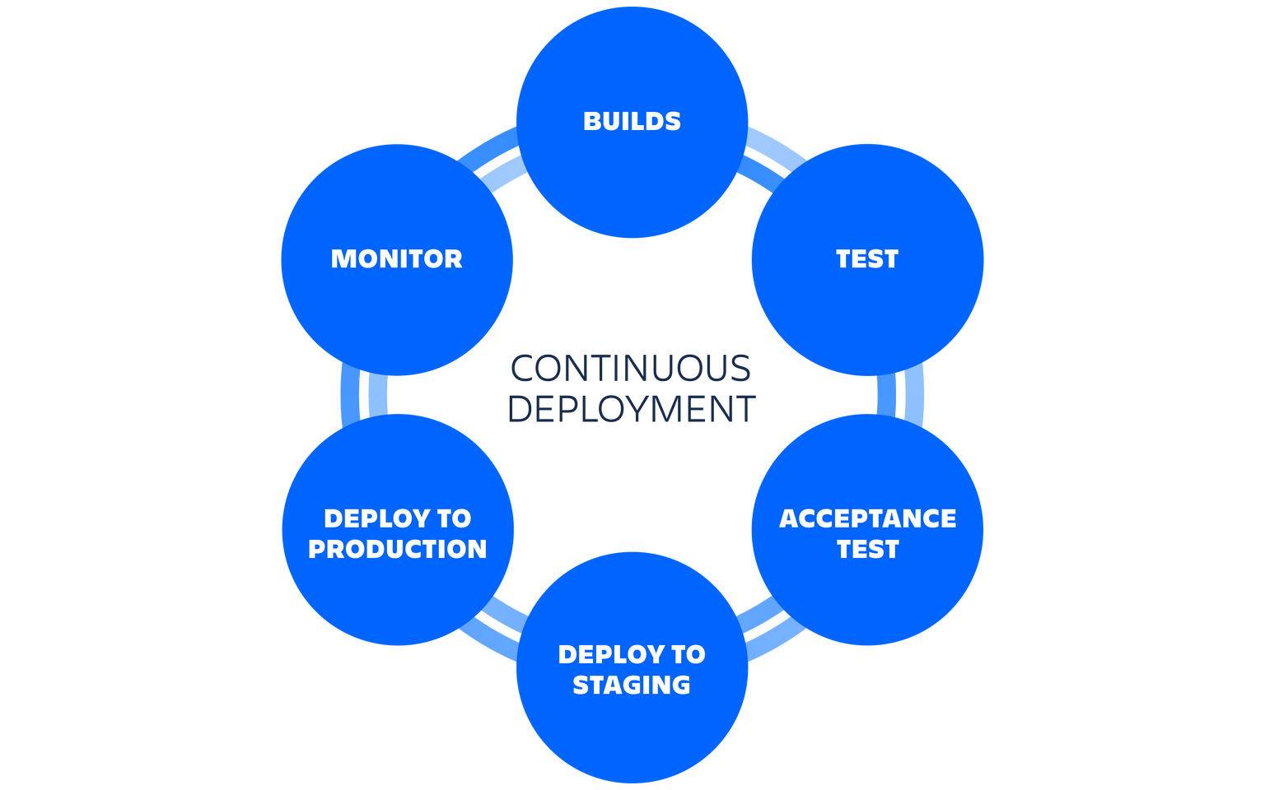
Who are the end users?

Slide 7
Our solution and its value proposition
Conditional formatting: It is a excel feature that is used to apply specific formatting to cells or range of cells in certain criteria.
Sort & filter: It helps to organize and analyse data more effectively.
Pivot table: It is used to summarize and analyse the data.
Chart: It is used to represent the data in visualisation.

Slide 8
Dataset description
Employee dataset: It is obtained from the edunet dashboard.
It has 11 features.
I have taken 5 features
Employee id: Numerical value
Name: Text type
Gender: Text type
Salary: Numerical values
Start date: Numerical value

Slide 9
The “WOW” in our solution
We used the formula for salary analysis:
= IFS(Z8>=5,”VERYHIGH”,Z8>=,”HIGH”,Z8>=3,”MED”,TRUE,”LOW”)

Slide 10
Modelling
DATA COLLECTION
FEATURE SELECTION
DATA CLEANING
This data is collected from naan mudhalvan edunet dashboard
It has 11 features
I took 5 features for analysis.
Conditional formatting: It is used to apply specific formatting to cells or range of cells in certain criteria.
Sort & filter: It helps to organize and analyse data more effectively.

Slide 11
PIVOT TABLE
CHART
SALARY LEVEL
Employee id
Name
Gender
Salary
Salary level
Start date
Employee type
Employee id
Salary
Salary level
Very High
High
Medium
Low

Slide 12
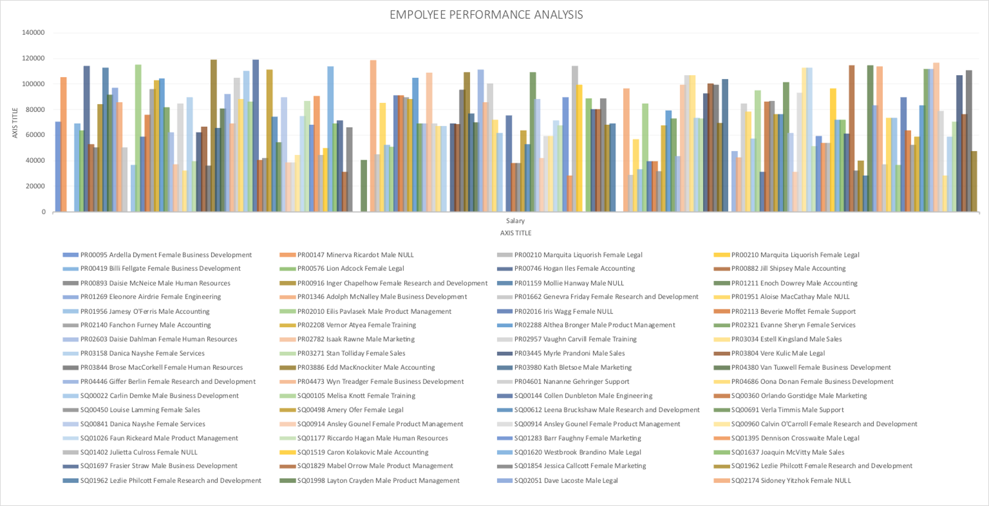
Result

Slide 13
Conclusion
By this project I learnt about sorting & filter, conditional formatting, removing null values, pivot table, inserting charts and also salary analysis.

